Slide 1
Lending club case study-mlc 61
Poonam attri
Kush shah

Slide 2
The Problem
What is the problem?
How to mitigate credit loss risk?
Who has this problem?
Lending Club – a consumer finance company
Why should this problem be solved?
To avoid loss of loan amount issued to high risk loan customers to mitigate credit loss
How will I know this problem has been solved?
By identifying factors which determine likelihood of loan default and taking informed decision

Slide 3
objective
Lending Club is a consumer finance company. Their objective is:
To identify factors which affect the likelihood of a loan repayment
To make an informed decision after assessing risk profile of a loan application
If customer is likely to repay loan, then not approving loan results in loss of business
If customer is likely to default, then approving the loan results in credit loss
Hence, risk mitigation is desired
Probable recommendations are solicited

Slide 4
approach
Business understanding
Key dependent variable is loan_status having 3 values
Fully paid, Charged Off, Current
Dataset analysis
Given dataset contains past loan applications
Objective is to identify key variables affecting dependent variable loan_status
Business objective
Mitigate risk profile in loan applications
Avoid credit loss as much as possible
Need to identify major factors which affect loan_status
Enable Lending Club with information about defaulting loan customer patterns
Onboard repaying customers to boost business

Slide 5
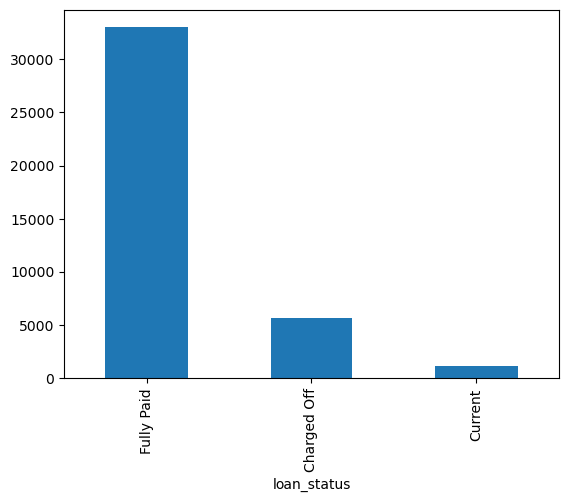
Distribution of loan status
More than 30k loans are fully paid
Around 5k loans are Charged Off
Less than a thousand loans are Current
<Insert a picture or drawing of your prototype here>

Slide 6
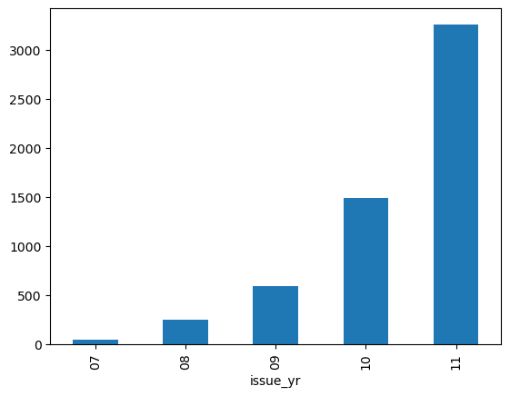
Loans issued across years
Most of Charged Off loans are issued in the year 2010-11
<Insert a picture or drawing of your prototype here>

Slide 7
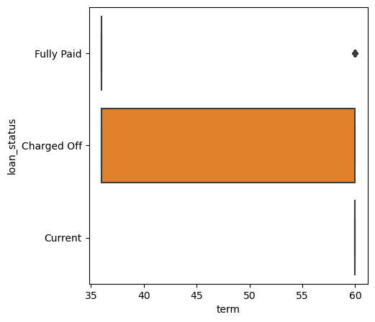
Term of charged off loans
It is noticed that Charged Off loans typically have a term of 35-60 months
Loans with shorter term than 35 months and longer than 60 months are fully paid
<Insert a picture or drawing of your prototype here>

Slide 8
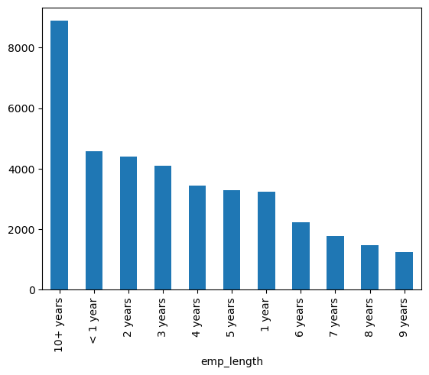
Employment length
It is noticed that most loan customers are employed for more than 10 years of tenure.
<Insert a picture or drawing of your prototype here>

Slide 9
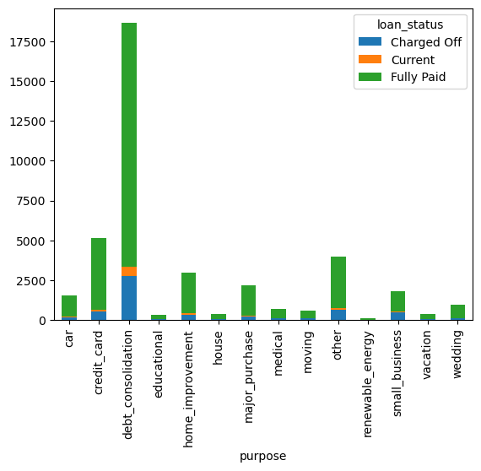
Purpose of loan
It is noticed that the most common purpose of loan among Charged Off loans is debt consolidation
<Insert a picture or drawing of your prototype here>

Slide 10
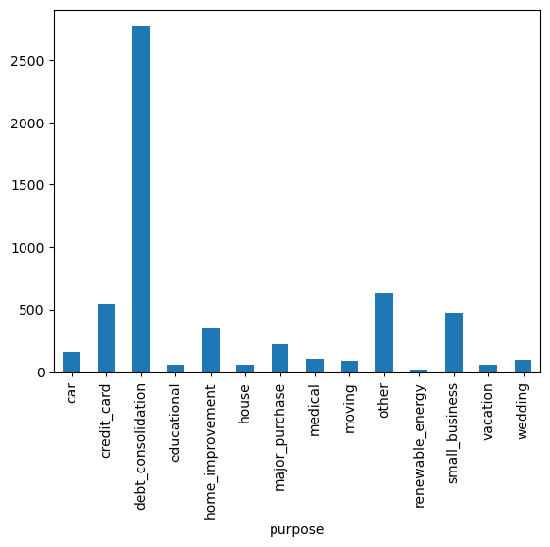
Purpose of loan
After debt consolidation and other, the most purpose of loan is credit card followed by small business.
Hence, credit card and small business loans need more vigilance during issuance.
<Insert a picture or drawing of your prototype here>

Slide 11
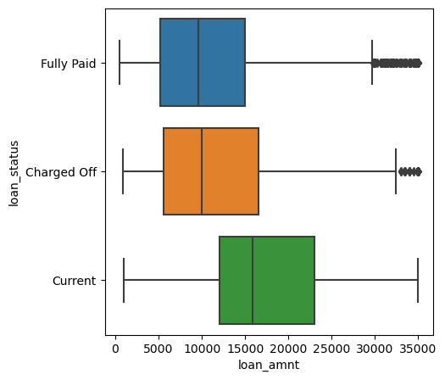
LOAN amount
Charged Off loans typically vary between 5k-15k of loan amount.
There does not seem to be a strong relation between loan amount and loan status
<Insert a picture or drawing of your prototype here>

Slide 12
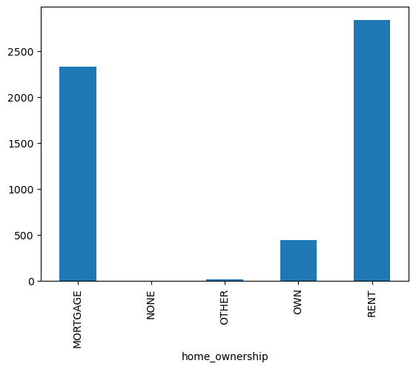
Home ownership
Loan applicants living in Rented or Mortgaged homes tend to default more than others.
<Insert a picture or drawing of your prototype here>

Slide 13
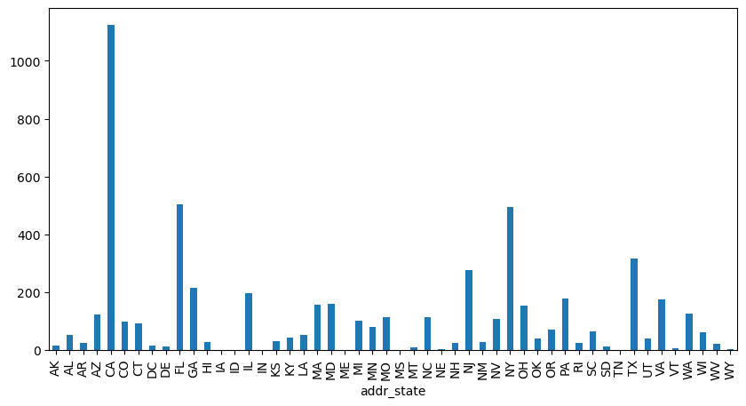
State of origin
States California(CA) has most Charged Off loans followed by Florida(FL) and New York(NY).
<Insert a picture or drawing of your prototype here>

Slide 14
Summary & recommendations
Most of the Lending Club's loan customers are employed for more than 10 years.
Most Charged Off loans were issued in the year 2010-11. There can be further enquiries into those two years' records.
Most Charged Off loans are issued for 35-60 months of term. Higher loan terms applications should be more scrutinized.

Slide 15
Summary & recommendations
Other than debt consolidation and Other purpose loans, Credit card purpose loans seem to be charged off more often followed Small business. Hence, credit card and small business loan maybe charged with higher interest rates.
Loan applicants living in rented or mortage homes tend to default more than others. Hence, these applications may be requested to have collateral support to mitigate risk.

Slide 16
Summary & recommendations
State California(CA) have most loan charged off followed by Florida(FL) and New York(NY). Loan applications in these states maybe charged with marginally higher interest rates than others.

